Slide 1
CS162 Operating Systems and Systems Programming Lecture 1 What is an Operating System?
January 21st, 2015
Prof. John Kubiatowicz
http://cs162.eecs.Berkeley.edu

Slide 2
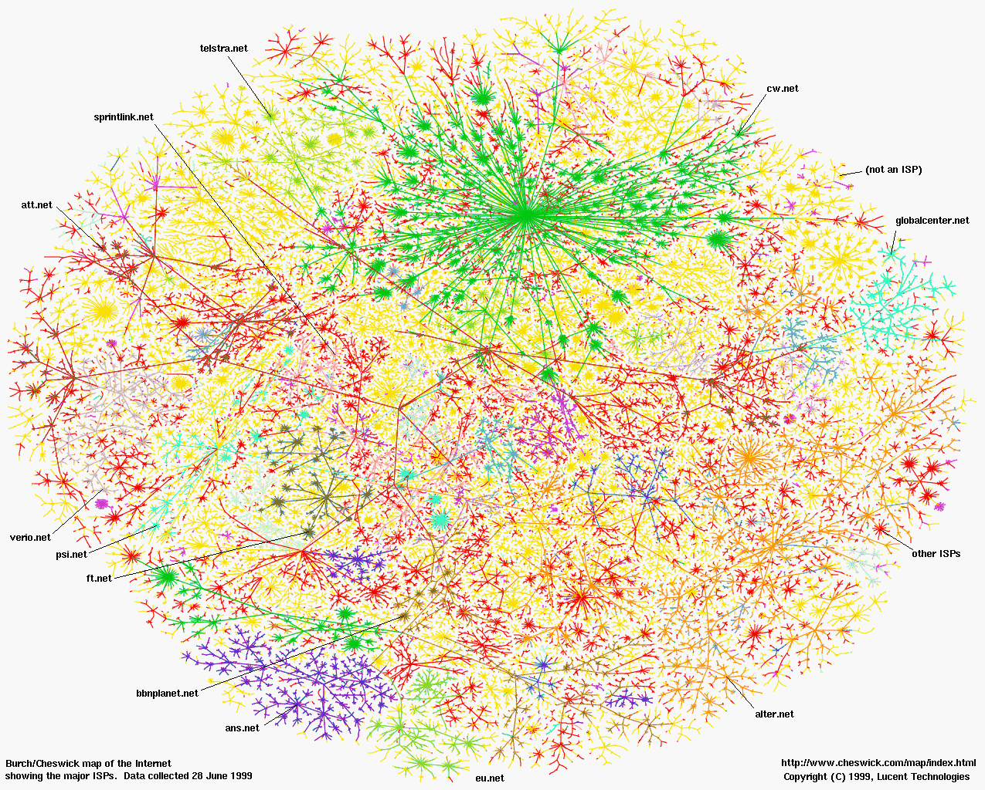
Greatest Artifact of Human Civilization…

Slide 3


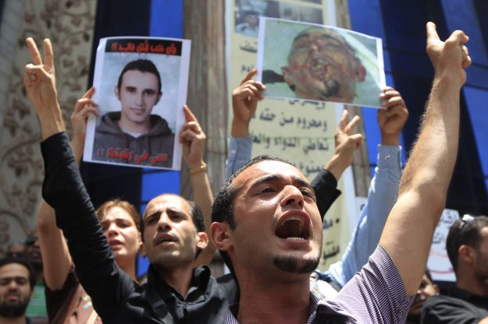
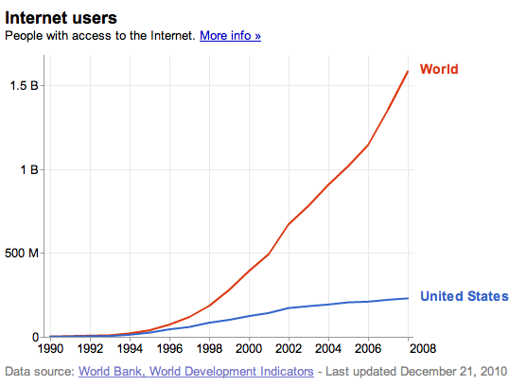
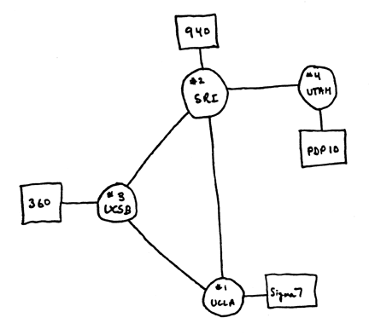
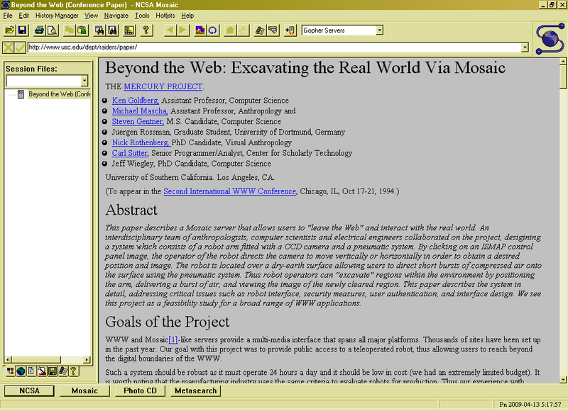
3 Billion Internet Users by …
2.8 B
Internet
WWW
2.0 B 1/26/11
ARPANet
RFC 675 TCP/IP
HTTP 0.9
1969
1974
1990
2010

Slide 4
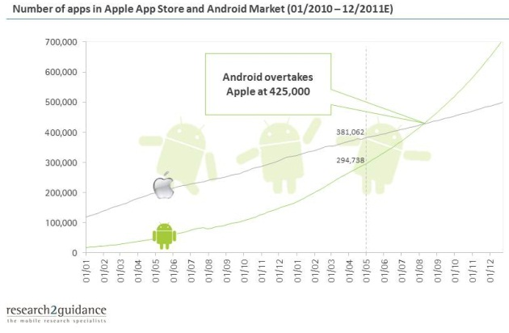
Operating Systems at the heart of it all …
Make the incredible advance in the underlying hardware available to a rapid evolving body of applications.
Processing, Communications, Storage, Interaction
The key building blocks
Scheduling
Concurrency
Address spaces
Protection, Isolation, Security
Networking, distributed systems
Persistent storage, transactions, consistency, resilience
Interfaces to all devices

Slide 5
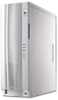
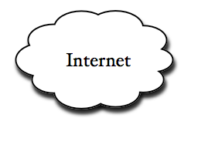
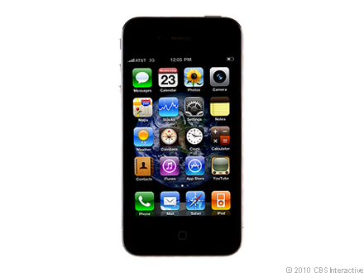
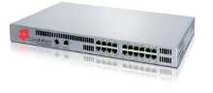
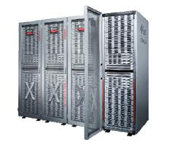
Example: What’s in a Search Query?
DNS
Servers
Datacenter
DNS
request
create
result
page
Search
Index
Page store
Load
balancer
Ad Server
Complex interaction of multiple components in multiple administrative domains
Systems, services, protocols, …
Notes:
In this course we are not focusing on a single node system but on the end-to-end system. The reason is very simple: today the majority of applications we use does not run on our system. Social networks, e-mail, google docs, online gamming, etc.

Slide 6
Why take CS162?
Some of you will actually design and build operating systems or components of them.
Perhaps more now than ever
Many of you will create systems that utilize the core concepts in operating systems.
Whether you build software or hardware
The concepts and design patterns appear at many levels
All of you will build applications, etc. that utilize operating systems
The better you understand their design and implementation, the better use you’ll make of them.

Slide 7
Goals for Today
What is an Operating System?
And – what is it not?
Examples of Operating Systems design
What makes Operating Systems So Exciting?
Oh, and “How does this class operate?”
Interactive is important!
Ask Questions!
Slides courtesy of David Culler, John Kubiatowicz, AJ Shankar, George Necula, Alex Aiken, Eric Brewer, Ras Bodik, Ion Stoica, Doug Tygar, and David Wagner.

Slide 8
What is an operating system?
Special layer of software that provides application software access to hardware resources
Convenient abstraction of complex hardware devices
Protected access to shared resources
Security and authentication
Communication amongst logical entities
appln
appln
appln
OS
Hardware

Slide 9
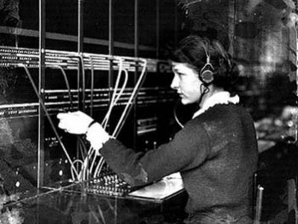
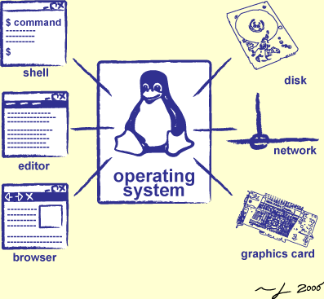
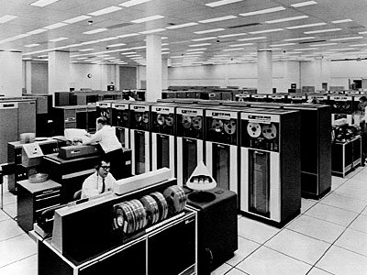
Operator …
Switchboard Operator
Computer Operators

Slide 10
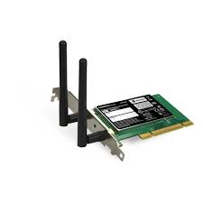
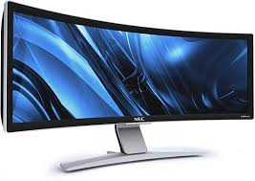

OS Basics: “Virtual Machine” Boundary
Threads
Address Spaces
Windows
Processes
Files
Sockets
Software
OS Hardware Virtualization
Hardware
ISA
Memory
Processor
Networks
storage
Displays
Inputs

Slide 11
Interfaces Provide Essential Boundaries
software
instruction set
hardware
Why do interfaces look the way that they do?
History, Functionality, Stupidity, Bugs, Management
CS152 ⇒ Machine interface
CS160 ⇒ Human interface
CS169 ⇒ Software engineering/management
Should responsibilities be pushed across boundaries?
RISC architectures, Graphical Pipeline Architectures

Slide 12
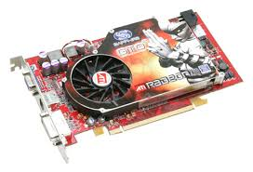
OS Basics: Program => Process
Threads
Address Spaces
Windows
Processes
Files
Sockets
Software
OS Hardware Virtualization
Hardware
ISA
Memory
Processor
OS
storage
Networks
Displays
Inputs

Slide 13
OS Basics: Context Switch
Threads
Address Spaces
Windows
Processes
Files
Sockets
Software
OS Hardware Virtualization
Hardware
ISA
Memory
Processor
OS
storage
Networks
Displays
Inputs

Slide 14
OS Basics: Scheduling, Protection
Threads
Address Spaces
Windows
Processes
Files
Sockets
Software
OS Hardware Virtualization
Hardware
ISA
Memory
Processor
Protection Boundary
OS
storage
Networks
Displays
Inputs

Slide 15
OS Basics: I/O
Threads
Address Spaces
Windows
Processes
Files
Sockets
Software
OS Hardware Virtualization
Hardware
ISA
Memory
Processor
Protection Boundary
OS
Ctrlr
storage
Networks
Displays
Inputs

Slide 16
OS Basics: Loading
Threads
Address Spaces
Windows
Processes
Files
Sockets
Software
OS Hardware Virtualization
Hardware
ISA
Memory
Processor
Protection Boundary
OS
Ctrlr
storage
Networks
Displays
Inputs

Slide 17
What make Operating Systems exciting and Challenging

Slide 18
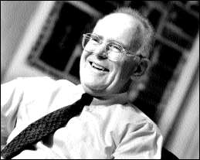
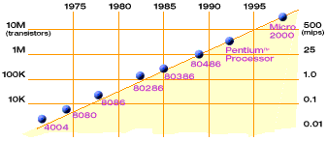
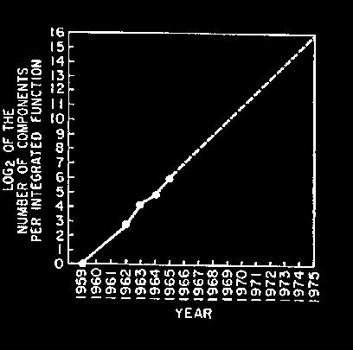
Technology Trends: Moore’s Law
Moore’s Law
2X transistors/Chip Every 1.5 years
Called “Moore’s Law”
Gordon Moore (co-founder of Intel) predicted in 1965 that the transistor density of semiconductor chips would double roughly every 18 months.
Microprocessors have become smaller, denser, and more powerful.

Slide 19
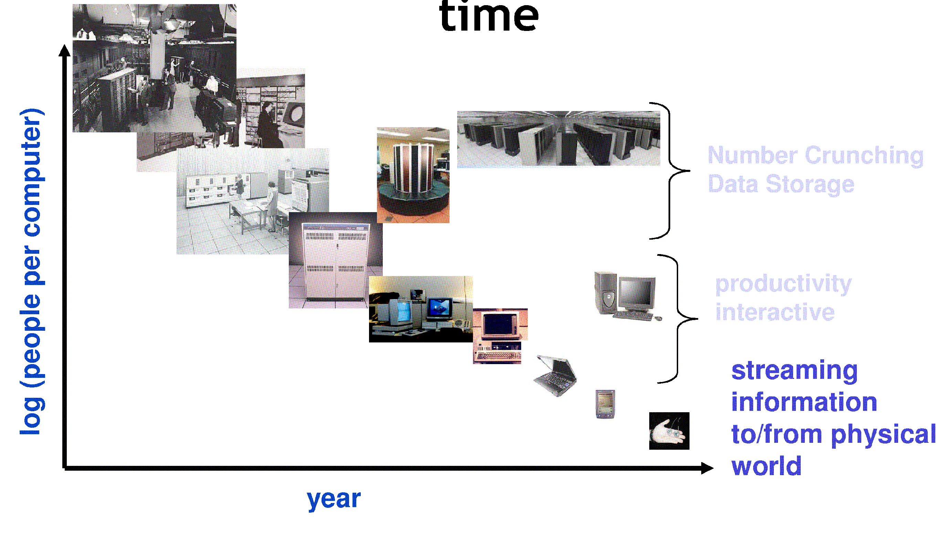
People-to-Computer Ratio Over Time
From David Culler
Today: Multiple CPUs/person!
Approaching 100s?

Slide 20
New Challenge: Slowdown in Joy’s law of Performance
3X
From Hennessy and Patterson, Computer Architecture: A Quantitative Approach, 4th edition, Sept. 15, 2006
⇒ Sea change in chip design: multiple “cores” or processors per chip
VAX : 25%/year 1978 to 1986
RISC + x86: 52%/year 1986 to 2002
RISC + x86: ??%/year 2002 to present

Slide 21
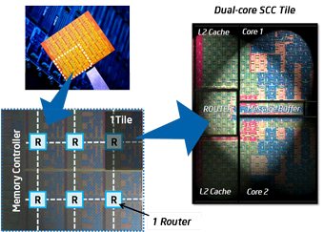
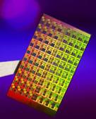
ManyCore Chips: The future is here
Intel 80-core multicore chip (Feb 2007)
80 simple cores
Two FP-engines / core
Mesh-like network
100 million transistors
65nm feature size
Intel Single-Chip Cloud Computer (August 2010)
24 “tiles” with two cores/tile
24-router mesh network
4 DDR3 memory controllers
Hardware support for message-passing
“ManyCore” refers to many processors/chip
64? 128? Hard to say exact boundary
How to program these?
Use 2 CPUs for video/audio
Use 1 for word processor, 1 for browser
76 for virus checking???
Parallelism must be exploited at all levels

Slide 22
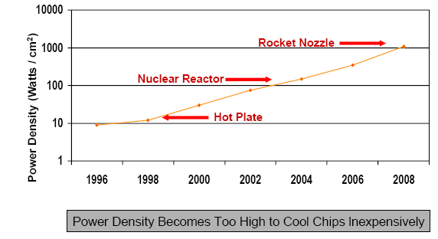
Another Challenge: Power Density
Moore’s Law Extrapolation
Potential power density reaching amazing levels!
Flip side: Battery life very important
Moore’s law can yield more functionality at equivalent (or less) total energy consumption

Slide 23
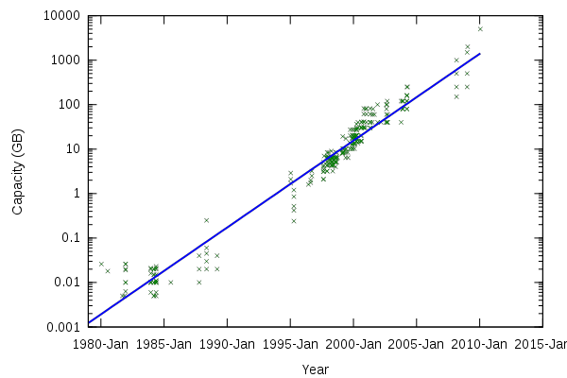
Storage Capacity
Retail hard disk capacity in GB (source: http://www.digitaltonto.com/2011/our-emergent-digital-future/ )

Slide 24
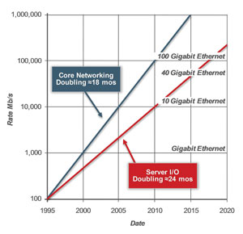
Network Capacity
(source: http://www.ospmag.com/issue/article/Time-Is-Not-Always-On-Our-Side )

Slide 25
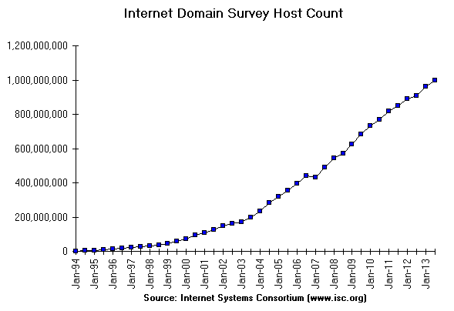
Internet Scale: .96 Billion Hosts
996,230,757
July 2013
963,518,598
https://www.isc.org/solutions/survey

Slide 26
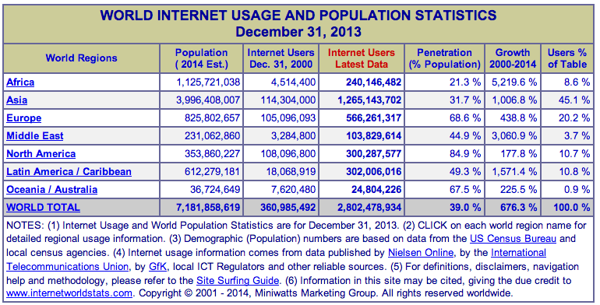
Internet Scale: Almost 2.5 Billion Users!
(source: http://www.internetworldstats.com/stats.htm)

Slide 27
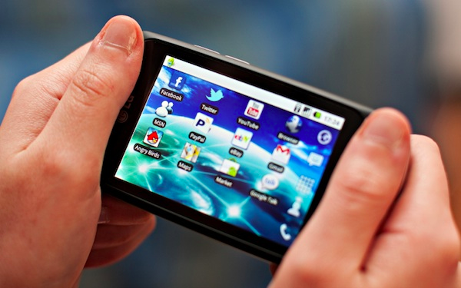
Not Only PCs connected to the Internet
Smartphone shipments now exceed PC shipments!
2011 shipments:
487M smartphones
414M PC clients
210M notebooks
112M desktops
63M tablets
25M smart TVs
4 billion phones in the world → smartphone over next decade

Slide 28
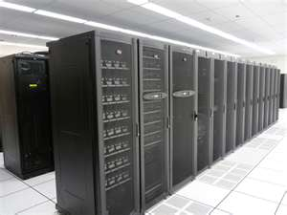
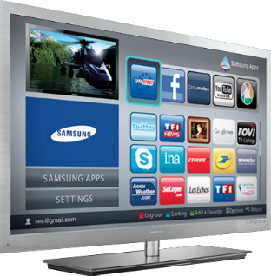
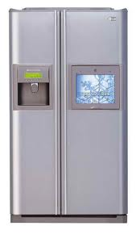
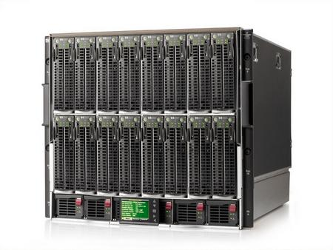
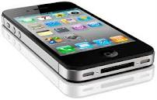
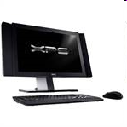
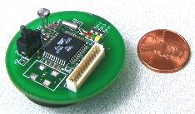
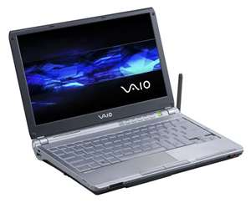
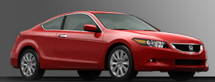
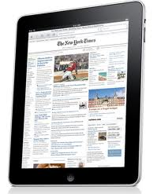
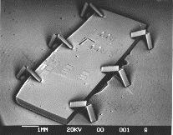

Societal Scale Information Systems (Or the “Internet of Things”?)
Massive Cluster
The world is a large distributed system
Microprocessors in everything
Vast infrastructure behind them
Gigabit Ethernet
Clusters
Massive Cluster
Clusters
Gigabit Ethernet
Internet Connectivity
Scalable, Reliable,
Secure Services
Databases
Information Collection
Remote Storage
Online Games
Commerce
…
MEMS for
Sensor Nets
Notes:
Of the enormous variety of CITRIS projects going on at Berkeley, I will present one set that is tied together by this picture: the design, construction and use of MEMS devices, the sensor networks containing them, and making the information from these networks available to widely distributed users as scalable, reliable and secure services.
The name we give to such an integrated system is a Societal Scale Information System, a name meant to evoke its scale – enormous - and purpose – benefiting people and the economy.
I will leave the details of all the specific applications that Ruzena mentioned, be it to energy efficiency or education or disaster response the social sciences, and indeed most details, to later talks and posters.

Slide 29
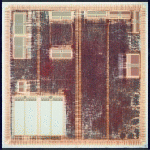
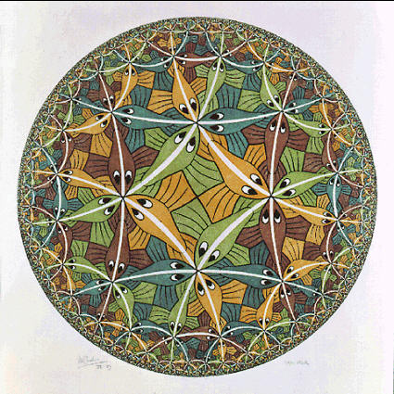


Who am I?
Professor John Kubiatowicz (Prof “Kubi”)
Background in Hardware Design
Alewife project at MIT
Designed CMMU, Modified SPAR C processor
Helped to write operating system
Background in Operating Systems
Worked for Project Athena (MIT)
OS Developer (device drivers, network file systems)
Worked on Clustered High-Availability systems (CLAM Associates)
OS lead researcher for Tessellation OS
Peer-to-Peer
OceanStore project – Store your data for 1000 years
Tapestry and Bamboo – Find your data around globe
SwarmLab Global DataPlane for the Internet of Things (IoT)
Quantum Computing
Well, this is just cool, but probably not apropos
Alewife
Tessellation
OceanStore

Slide 30
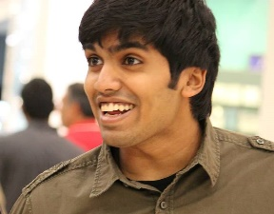
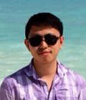
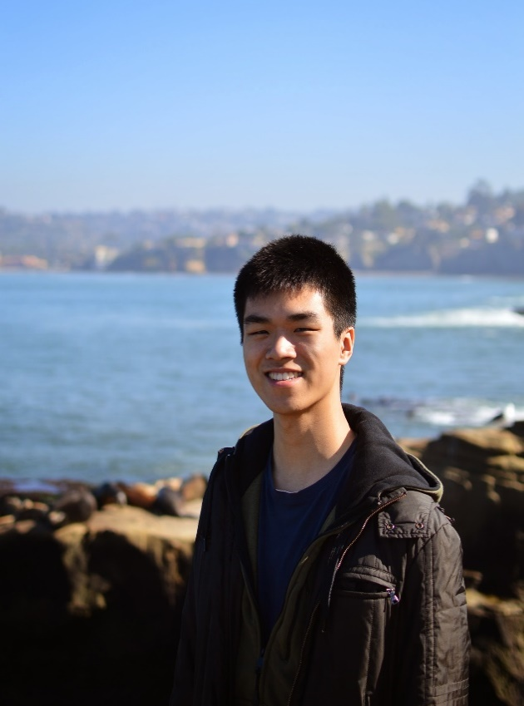
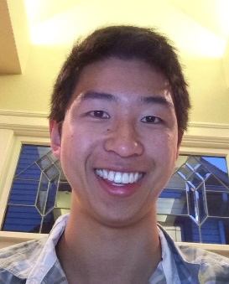
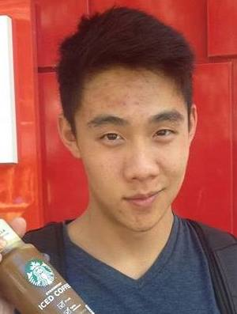
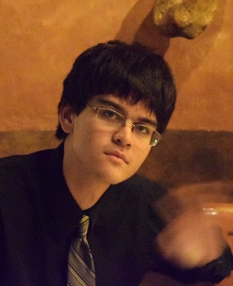
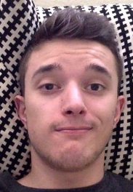
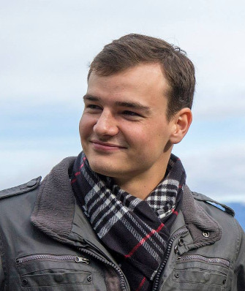

CS162 Team - GSIs:
Vaishaal Shankar
Head GSI
Sec: 105 (Th 2-3P)
cs162-ta@inst.eecs.berkeley.edu
Roger Chen
Sec: 106 (Th 3-4P), 107 (Th 4-5P)
cs162-tb@inst.eecs.berkeley.edu
Jason Jia
Sec: 102 (F 11-12P)
cs126-tc@inst.eecs.berkeley.edu
Erik Krogen
Sec: 103 (F 10-11P)
cs162-td@inst.eecs.berkeley.edu
Daniel Liu
Sec: 112 (F 3-4P)
cs162-te@inst.eecs.berkeley.edu
William Liu
Sec: 109 (F 10-11A)
cs162-tf@inst.eecs.berkeley.edu
Alec Mouri
Sec: 101 (Th 10-11A), 102 (Th 11-12P)
cs162-tg@inst.eecs.berkeley.edu
Luca Zuccarini
Sec: 111 (F 2-3P)
cs162-th@inst.eecs.berkeley.edu
Iris Wang
Sec: 104 (Th 1-2P), 108 (Th 5-6P)
cs162-ti@inst.eecs.berkeley.edu

Slide 31


Infrastructure, Textbook & Readings
Infrastructure
Website: http://cs162.eecs.berkeley.edu
Piazza: https://piazza.com/berkeley/spring2015/cs162
Webcast: Yes! Will post link when available
Textbook: Operating Systems: Principles and Practice (2nd Edition) Anderson and Dahlin
Recommend: Operating Systems Concepts, 9th Edition Silbershatz, Galvin, Gagne
Copies in Bechtel
Online supplements
See course website
Includes Appendices, sample problems, etc.
Networking, Databases, Software Eng, Security
Some Research Papers!

Slide 32
Syllabus
OS Concepts: How to Navigate as a Systems Programmer!
Process, I/O, Networks and VM
Concurrency
Threads, scheduling, locks, deadlock, scalability, fairness
Address Space
Virtual memory, address translation, protection, sharing
File Systems
i/o devices, file objects, storage, naming, caching, performance, paging, transactions, databases
Distributed Systems (8)
Protocols, N-Tiers, RPC, NFS, DHTs, Consistency, Scalability, multicast
Reliability & Security
Fault tolerance, protection, security
Cloud Infrastructure

Slide 33
Learning by Doing
Individual Homework (1-2 weeks): Learn Systems Programming
0. Tools, Autograding, recall C, executable
1. Simple Shell
2. Web server
…
Three Group Projects
1. Threads & Scheduling (Pintos in C )
2. User-programs (Pintos in C)
3. Key-value store (Java)

Slide 34
Getting started
Start homework 0 immediately
Gets cs162-xx@cory.eecs.berkeley.edu (and other inst m/c)
Github account
Registration survey
Vagrant virtualbox – VM environment for the course
Consistent, managed environment on your machine
icluster24.eecs.berkeley.edu is same
Get familiar with all the cs162 tools
Submit to autograder via git
Go to section this week (starting tomorrow!)
Also, watch for us to post various small help-sessions
Waitlist ???
Drop Deadline: January 30th
If you are not serious about taking, please drop early

Slide 35
Group Project Simulates Industrial Environment
Project teams have 4 members (try really hard to get 4 members – 3 members requires serious justification)
Must work in groups in “the real world”
Same section much perferred
Communicate with colleagues (team members)
Communication problems are natural
What have you done?
What answers you need from others?
You must document your work!!!
Communicate with supervisor (TAs)
What is the team’s plan?
What is each member’s responsibility?
Short progress reports are required
Design Documents: High-level description for a manager!

Slide 36
Grading
40% midterms/Final
40% projects
15% homework
5% participation
Project grading
[10 pts] Initial design
[10 pts] Design review
[50 pts] Code (3 checkpoints)
[30 pts] Final design
[0 pts] Peer Evaluation
Submission via git push to release branch
Triggers autograder
Regular git push so TA sees your progress

Slide 37
Personal Integrity
UCB Academic Honor Code: "As a member of the UC Berkeley community, I act with honesty, integrity, and respect for others."
http://asuc.org/honorcode/resources/HC%20Guide%20for%20Syllabi.pdf

Slide 38


CS 162 Collaboration Policy
Explaining a concept to someone in another group
Discussing algorithms/testing strategies with other groups
Helping debug someone else’s code (in another group)
Searching online for generic algorithms (e.g., hash table)
Sharing code or test cases with another group
Copying OR reading another group’s code or test cases
Copying OR reading online code or test cases from from prior years
We compare all project submissions against prior year submissions and online solutions and will take actions (described on the course overview page) against offenders

Slide 39
Typical Lecture Format
Attention
20 min.
Break
25 min.
Break
25 min.
“In Conclusion, ...”
Time
1-Minute Review
20-Minute Lecture
5- Minute Administrative Matters
25-Minute Lecture
5-Minute Break (water, stretch)
25-Minute Lecture
Instructor will come to class early & stay after to answer questions

Slide 40
Lecture Goal
Interactive!!!

Slide 41



What is an Operating System?
Referee
Manage sharing of resources, Protection, Isolation
Resource allocation, isolation, communication
Illusionist
Provide clean, easy to use abstractions of physical resources
Infinite memory, dedicated machine
Higher level objects: files, users, messages
Masking limitations, virtualization
Glue
Common services
Storage, Window system, Networking
Sharing, Authorization
Look and feel

Slide 42
Challenge: Complexity
Applications consisting of…
… a variety of software modules that …
… run on a variety of devices (machines) that
… implement different hardware architectures
… run competing applications
… fail in unexpected ways
… can be under a variety of attacks
Not feasible to test software for all possible environments and combinations of components and devices
The question is not whether there are bugs but how serious are the bugs!

Slide 43

A modern processor: SandyBridge
Package: LGA 1155
1155 pins
95W design envelope
Cache:
L1: 32K Inst, 32K Data (3 clock access)
L2: 256K (8 clock access)
Shared L3: 3MB – 20MB (not out yet)
Transistor count:
504 Million (2 cores, 3MB L3)
2.27 Billion (8 cores, 20MB L3)
Note that ring bus is on high metal layers – above the Shared L3 Cache

Slide 44

Functionality comes with great complexity!
SandyBridge I/O
Configuration
Proc
Caches
Busses
adapters
Memory
Controllers
Disks
Displays
Keyboards
I/O Devices:
Networks

Slide 45
Sample of Computer Architecture Topics
Input/Output and Storage
SSD, Disks, Cloud Storage
RAID/Replication
Emerging Technologies
Interleaving
Bus protocols
DRAM
Memory
Hierarchy
Coherence,
Bandwidth,
Latency
L2 Cache
Network
Communication
Other Processors
L1 Cache
Addressing,
Protection,
Exception Handling
VLSI
Instruction Set Architecture
Pipelining, Hazard Resolution,
Superscalar, Reordering,
Prediction, Speculation,
Vector, Dynamic Compilation
Pipelining and Instruction
Level Parallelism

Slide 46

Increasing Software Complexity
From MIT’s 6.033 course

Slide 47

Example: Some Mars Rover (“Pathfinder”) Requirements
Pathfinder hardware limitations/complexity:
20Mhz processor, 128MB of DRAM, VxWorks OS
cameras, scientific instruments, batteries, solar panels, and locomotion equipment
Many independent processes work together
Can’t hit reset button very easily!
Must reboot itself if necessary
Must always be able to receive commands from Earth
Individual Programs must not interfere
Suppose the MUT (Martian Universal Translator Module) buggy
Better not crash antenna positioning software!
Further, all software may crash occasionally
Automatic restart with diagnostics sent to Earth
Periodic checkpoint of results saved?
Certain functions time critical:
Need to stop before hitting something
Must track orbit of Earth for communication
A lot of similarity with the Internet of Things?
Complexity, QoS, Inaccessbility, Power limitations … ?
Notes:
Distance 186 light secs to 21 light minutes one-way
Nearly two earth years

Slide 48
How do we tame complexity?
Every piece of computer hardware different
Different CPU
Pentium, PowerPC, ColdFire, ARM, MIPS
Different amounts of memory, disk, …
Different types of devices
Mice, Keyboards, Sensors, Cameras, Fingerprint readers
Different networking environment
Cable, DSL, Wireless, Firewalls,…
Questions:
Does the programmer need to write a single program that performs many independent activities?
Does every program have to be altered for every piece of hardware?
Does a faulty program crash everything?
Does every program have access to all hardware?

Slide 49
OS Tool: Virtual Machine Abstraction
Application
Operating System
Hardware
Virtual Machine Interface
Physical Machine Interface
Software Engineering Problem:
Turn hardware/software quirks ⇒ what programmers want/need
Optimize for convenience, utilization, security, reliability, etc…
For Any OS area (e.g. file systems, virtual memory, networking, scheduling):
What’s the hardware interface? (physical reality)
What’s the application interface? (nicer abstraction)

Slide 50




Virtual Machines
Software emulation of an abstract machine
Give programs illusion they own the machine
Make it look like hardware has features you want
Two types of “Virtual Machine”s
Process VM: supports the execution of a single program; this functionality typically provided by OS
System VM: supports the execution of an entire OS and its applications (e.g., VMWare Fusion, Virtual box, Parallels Desktop, Xen)

Slide 51
Process VMs
Programming simplicity
Each process thinks it has all memory/CPU time
Each process thinks it owns all devices
Different devices appear to have same high level interface
Device interfaces more powerful than raw hardware
Bitmapped display ⇒ windowing system
Ethernet card ⇒ reliable, ordered, networking (TCP/IP)
Fault Isolation
Processes unable to directly impact other processes
Bugs cannot crash whole machine
Protection and Portability
Java interface safe and stable across many platforms

Slide 52

System Virtual Machines: Layers of OSs
Useful for OS development
When OS crashes, restricted to one VM
Can aid testing programs on other OSs

Slide 53
What is an Operating System,… Really?
Most Likely:
Memory Management
I/O Management
CPU Scheduling
Communications? (Does Email belong in OS?)
Multitasking/multiprogramming?
What about?
File System?
Multimedia Support?
User Interface?
Internet Browser? ☺
Is this only interesting to Academics??

Slide 54
Operating System Definition (Cont.)
No universally accepted definition
“Everything a vendor ships when you order an operating system” is good approximation
But varies wildly
“The one program running at all times on the computer” is the kernel.
Everything else is either a system program (ships with the operating system) or an application program

Slide 55
Example: Protecting Processes from Each Other
Problem: Run multiple applications in such a way that they are protected from one another
Goal:
Keep User Programs from Crashing OS
Keep User Programs from Crashing each other
[Keep Parts of OS from crashing other parts?]
(Some of the required) Mechanisms:
Address Translation
Dual Mode Operation
Simple Policy:
Programs are not allowed to read/write memory of other Programs or of Operating System

Slide 56

Address Translation
Address Space
A group of memory addresses usable by something
Each program (process) and kernel has potentially different address spaces.
Address Translation:
Translate from Virtual Addresses (emitted by CPU) into Physical Addresses (of memory)
Mapping often performed in Hardware by Memory Management Unit (MMU)
Virtual
Addresses
Physical
Addresses
CPU
MMU

Slide 57
Example of Address Translation
Code
Data
Heap
Stack
Data 2
Code
Data
Heap
Stack
Stack 1
Heap 1
Code 1
Stack 2
Prog 1
Virtual
Address
Space 1
Data 1
Prog 2
Virtual
Address
Space 2
Heap 2
Code 2
OS code
Translation Map 1
OS data
Translation Map 2
OS heap &
Stacks
Physical Address Space

Slide 58
Address Translation Details
For now, assume translation happens with table (called a Page Table):
Translation helps protection:
Control translations, control access
Should Users be able to change Page Table???
10
Virtual
Address
V page no.
offset
Page Table
V
Access
Rights
PA
index
into
page
table
table located
in physical
memory
P page no.
offset
Physical
Address
10

Slide 59

Dual Mode Operation
Hardware provides at least two modes:
“Kernel” mode (or “supervisor” or “protected”)
“User” mode: Normal programs executed
Some instructions/ops prohibited in user mode:
Example: cannot modify page tables in user mode
Attempt to modify ⇒ Exception generated
Transitions from user mode to kernel mode:
System Calls, Interrupts, Other exceptions

Slide 60

UNIX System Structure
Applications
User Mode
Standard Libs
Kernel Mode
Hardware

Slide 61
“In conclusion…”
Operating systems provide a virtual machine abstraction to handle diverse hardware
Operating systems coordinate resources and protect users from each other
Operating systems simplify application development by providing standard services
Operating systems can provide an array of fault containment, fault tolerance, and fault recovery
CS162 combines things from many other areas of computer science –
Languages, data structures, hardware, and algorithms

